Slide 1

Swiggy Style Food Delivery Website
website Built Using HTML,CSS,Bootstrap,JavaScript
Name: Himaja
Teacher: Vineeth Godishela

Slide 2
Introduction
This project is a Swiggy‑style food delivery website built using HTML, CSS, Bootstrap and JavaScript.
It includes Home, Index (Food Delivery), and Menu pages with dynamic search, filters, and UI components.
It also consists of Instamart page and Dineout page as well
The website replicates modern food delivery platform functionality including restaurant listings,
categories, filtering, and cart operations.

Slide 3
Objectives
Provide a clean and modern UI for food delivery.
Display restaurants with images, categories, ratings, menus, and filters.
Allow users to search for restaurants, items, and cuisines.
Implement interactive menu with Add to Cart and Quantity Update.
Built a Responsive and Dynamic User Friendly website

Slide 4
Technologies & tools
HTML5 for structure
CSS3 for styling, layout, animations
Bootstrap Icons for UI icons
JavaScript for dynamic search, filters, and cart
LocalStorage for maintaining selected restaurant and cart
Responsive design techniques using media queries

Slide 5
Home page
Header with branding and navigation links.
Central section with tagline and search.
Location box and search bar direct users to index.html.
Clean orange theme matching Swiggy brand.
Cards that display Food delivery, InstaMart,Dineout .OnClick will redirect to corresponding pages .

Slide 6
Header
Sticky header with brand icon, city selector, search bar, sign in ,help and cart.
Search uses dynamic suggestions and keyword match. Autocomplete UI and Suggestions will appear below
Auto-suggest dropdown loaded via JavaScript
Cart badge updates live.
Fully responsive with mobile behavior adjustments.

Slide 7
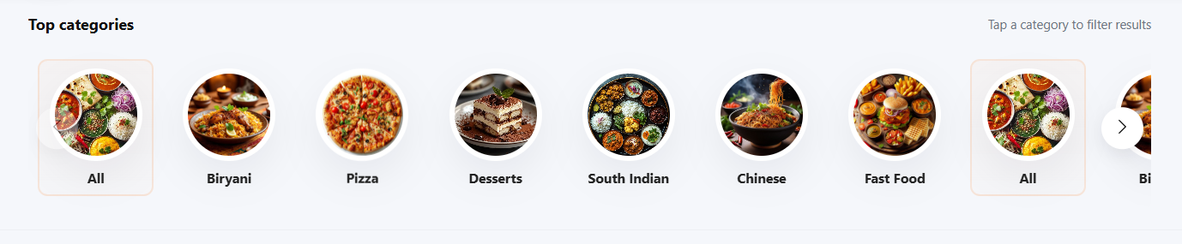
Category Carousel
Scrollable horizontal list of food categories.
Category selection filters restaurants.
Custom arrows for smooth transitions.
Fully responsive with breakpoints for smaller screens.

Slide 8
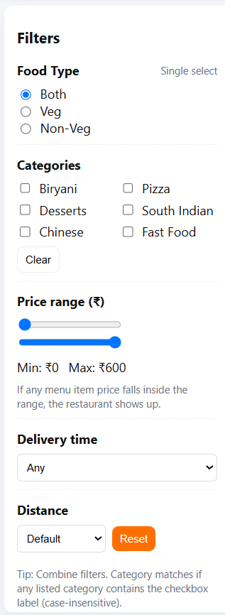
Sidebar Filters
Filters include:
Veg / Non‑Veg (single select)(Radio buttons)
Categories(multi‑select)(CheckBoxes)
Price Range slider (min/max)(Range Bar)
Delivery Time filter(Dropdown)
Distance sort(Dropdown)
All filters update restaurant list dynamically.

Slide 9
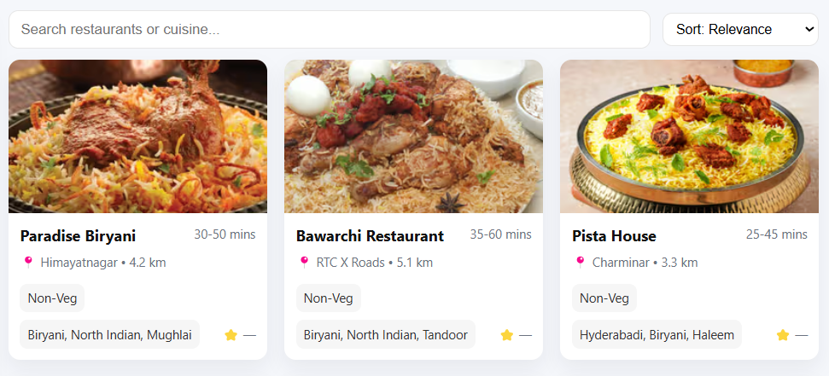
Resturant Grid
Cards display restaurant image, name, categories, price range, and delivery time.
Clicking a restaurant stores it in LocalStorage and opens its menu.
Search bar filters results live.
Skeleton loading is shown while data loads.

Slide 10
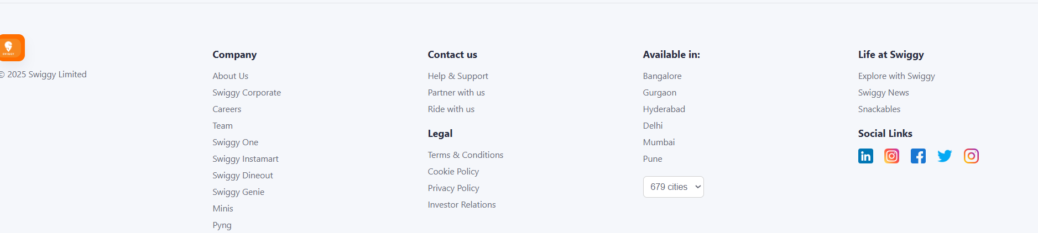
Footer
Multi‑column footer with links, policies, cities, social media icons.
App store buttons, company info, and Swiggy branding included.
Fully responsive grid layout.

Slide 11
Dineout -Overview
The Dineout page showcases top dining restaurants with a modern, responsive layout.
It includes search, advanced filtering, sorting, cuisine categories, and dynamic restaurant cards.
All UI components are powered by Bootstrap and JavaScript .

Slide 12
Dineout -Navbar
Clean white Bootstrap navbar.
Contains: Dineout logo, search bar, Login/Logout button.
Login state verified via localStorage.
Logged-in users see 'Logout'; others redirected to signin.html.
Mobile-responsive design ensures smooth experience.

Slide 13
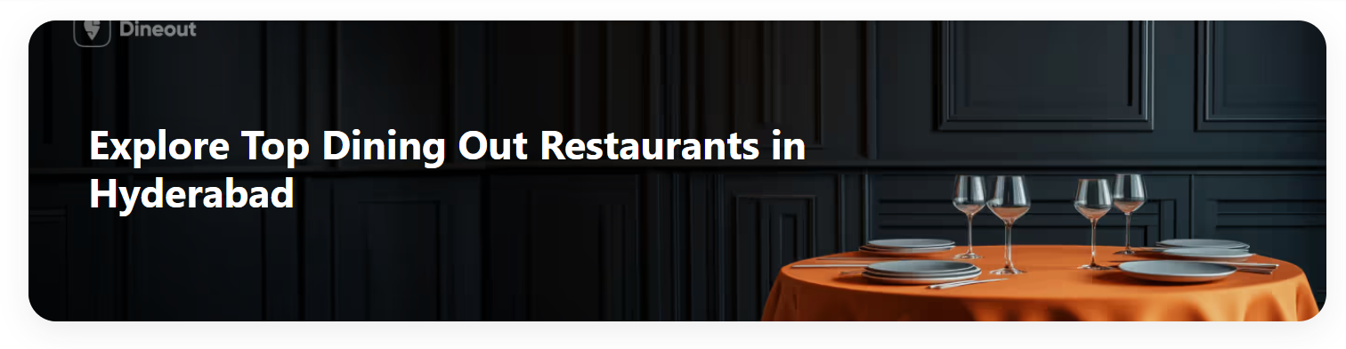
Dineout -Banner
Large hero banner with fixed-height card styling.
Background image uses Swiggy-style marketing banner.
Overlay contains main title: 'Explore Top Dining Out Restaurants in Hyderabad'.
Provides premium look and sets context for the page.

Slide 14
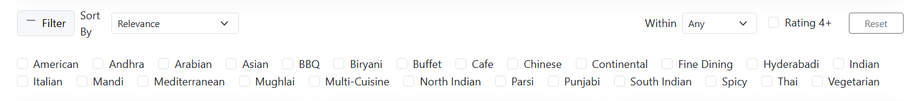
Dineout -Filter &Sort
The control bar includes:
Filter button – opens custom filter panel via script.js.
Sorting dropdown – Relevance, Rating High→Low, Price Low→High, Distance Near→Far, A→Z.
Distance filter – Search within 5, 10, 15 km.
Rating 4+ checkbox – Filters high-rated restaurants.
Reset button – Clears all filters instantly.
Examples: Chinese, Italian, North Indian, South Indian, Bakery, etc.
Users can multi-select cuisines.
Filters instantly update restaurant results.

Slide 15
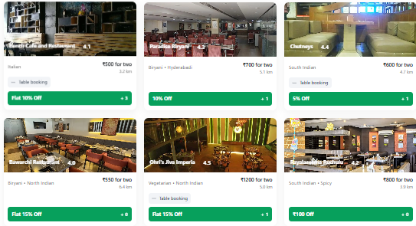
Dineout -Cards Grid Layout
Each restaurant card shows image, name, cuisine, distance, rating, and price.
Cards are generated dynamically based on JSON restaurant data in script.js.
Bootstrap grid ensures responsive layout (row g-4).
Sorting, searching, and filtering all change this list in real-time.
Provides seamless browsing experience for users.

Slide 16
Dineout -details onClick
← Back to list' button leads to dineout.html.
Page structured within a clean container (Bootstrap spacing).
Fully responsive on mobile devices.
Dineout page stores selected restaurant in localStorage.
JS creates dynamic HTML (image, title, cuisines, offers).

Slide 17
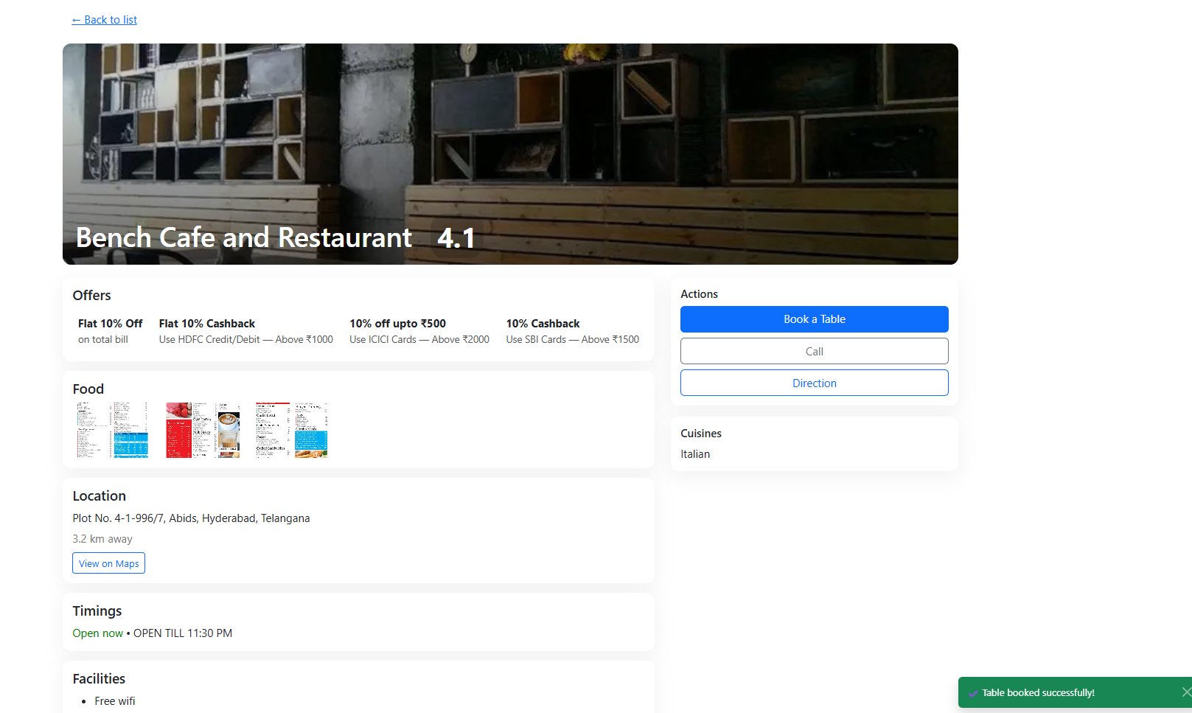
Dineout -Table Booking
Includes a 'Book Table' button
Clicking it triggers Bootstrap Toast.
Toast message: '✔ Table booked successfully!'
Toast appears at bottom-right of screen.
Adds real-world interactivity and UX feedback.

Slide 18
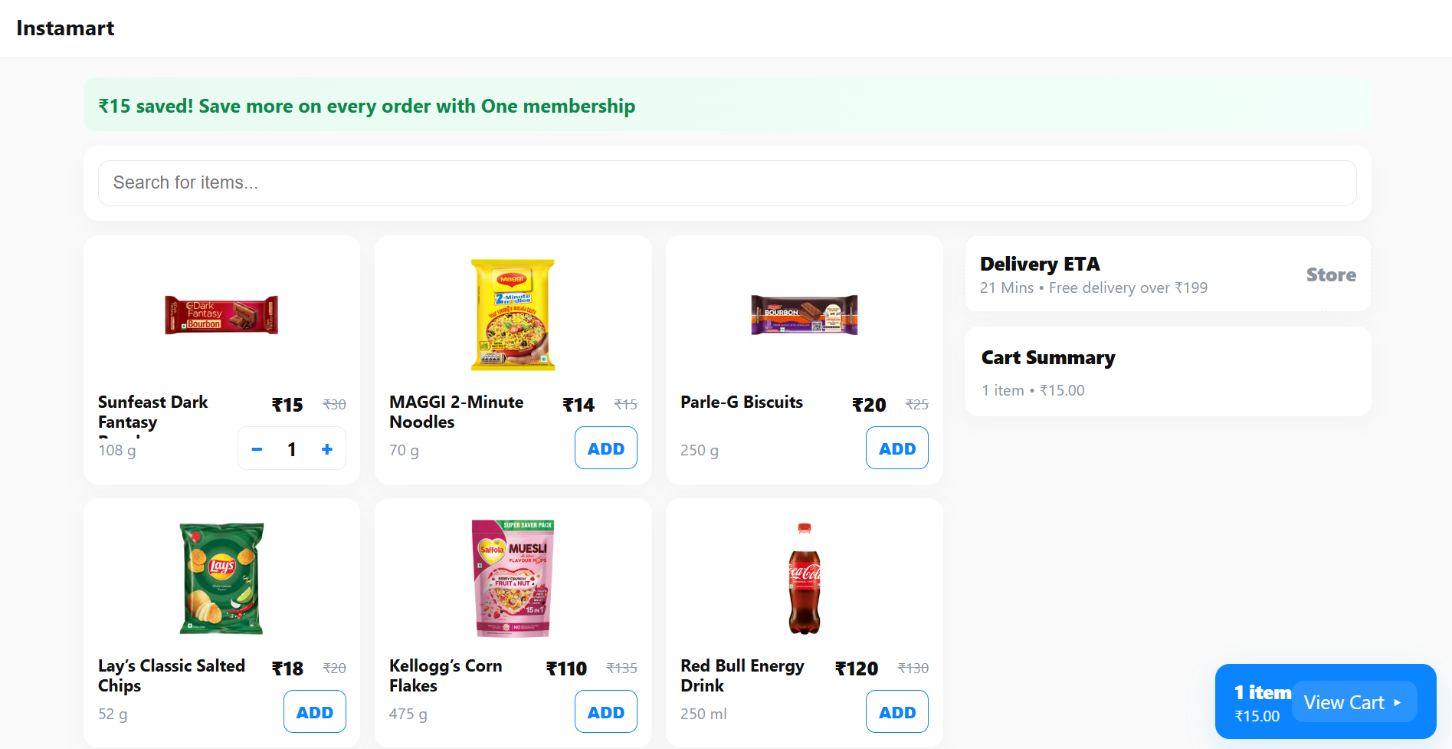
Instamart -Overview
Displays store items in a responsive grid layout.
Includes search bar, membership banner, and right-side delivery ETA panel.
Items include price, original price, weight, and add/quantity controls.
Floating bottom cart updates dynamically as items are added.

Slide 19
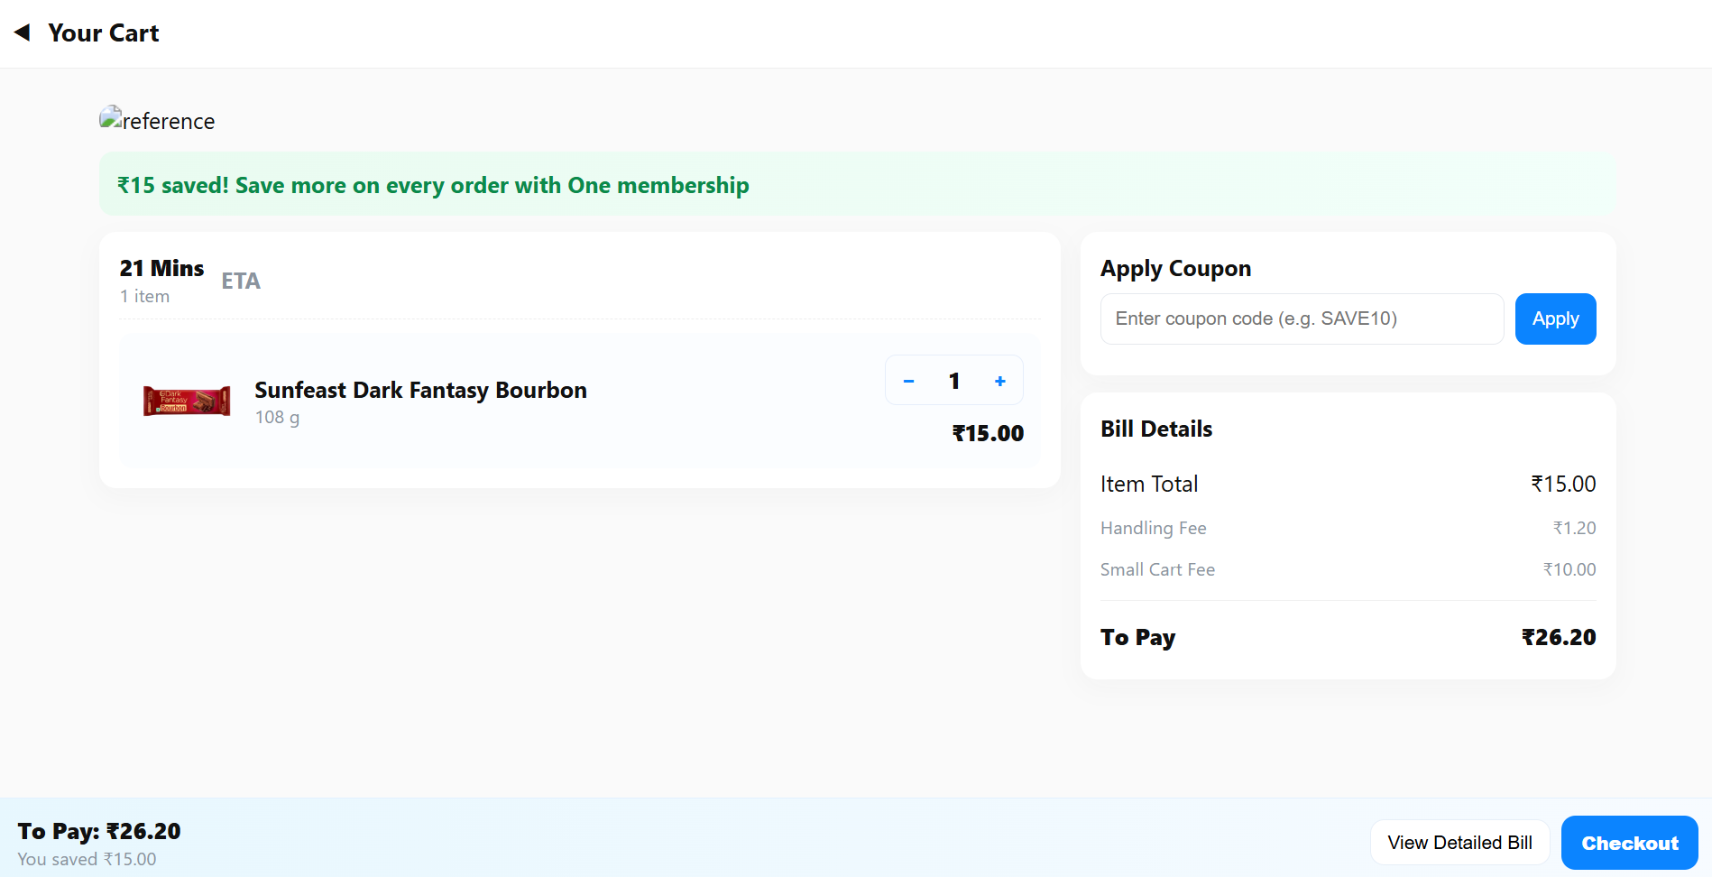
Instamart -Cart
• Displays user's cart items with quantity controls.
• Shows delivery ETA, membership banner, and screenshot reference.
• Includes coupon system, bill breakdown, and sticky bottom checkout bar.
• Uses JavaScript to manage cart items, billing logic, and coupon validation.

Slide 20
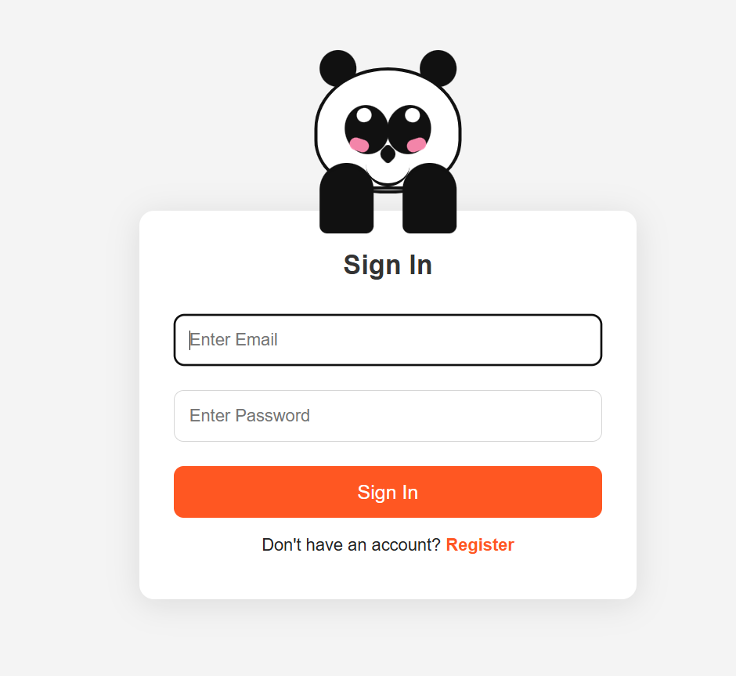
Instamart -Overview
Animated panda reacts to email and password focus.
Login and register forms switch dynamically.
User authentication stored via LocalStorage.
Successful login redirects to index.html.

Slide 21
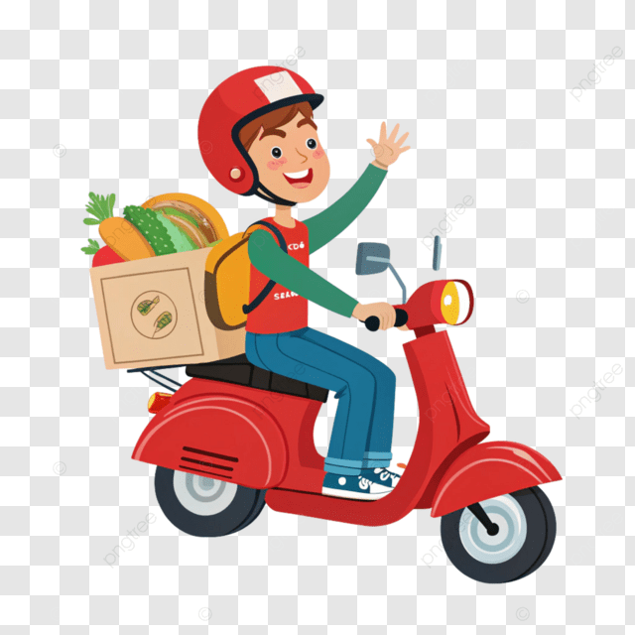
THANKS YOU

